Slide 1
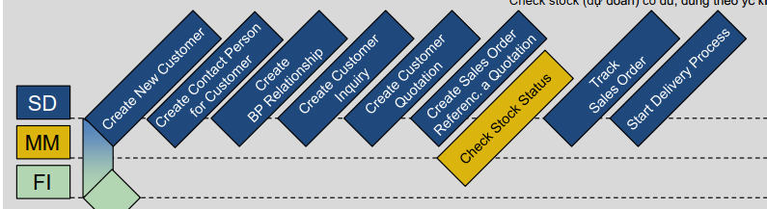
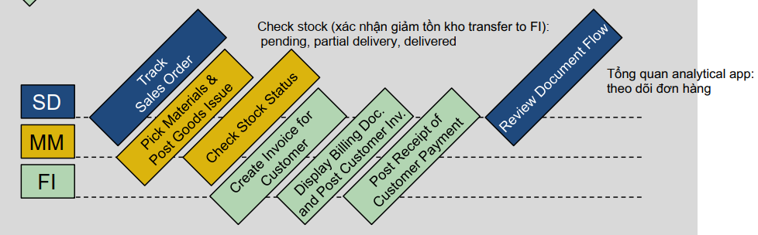

Slide 2
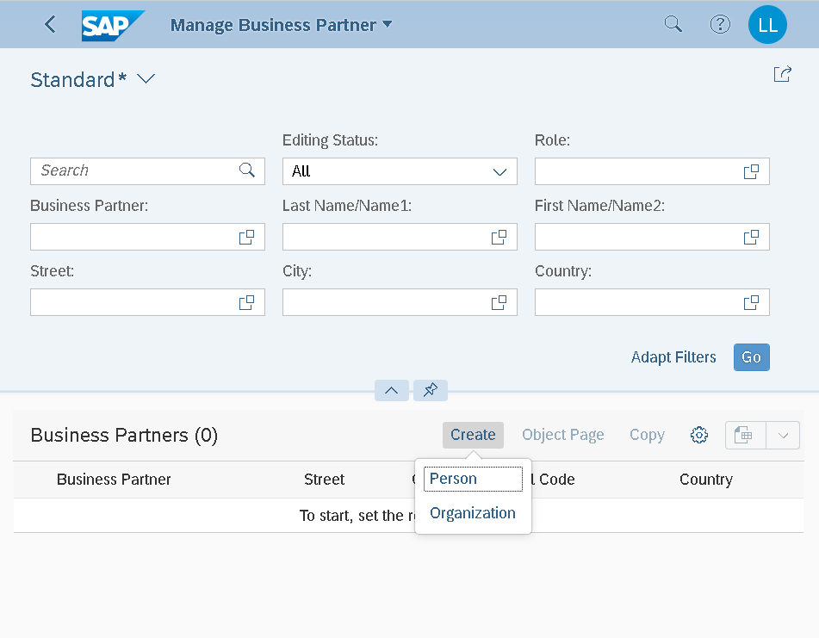
Notes:
Organization: Customer Partner number

Slide 3
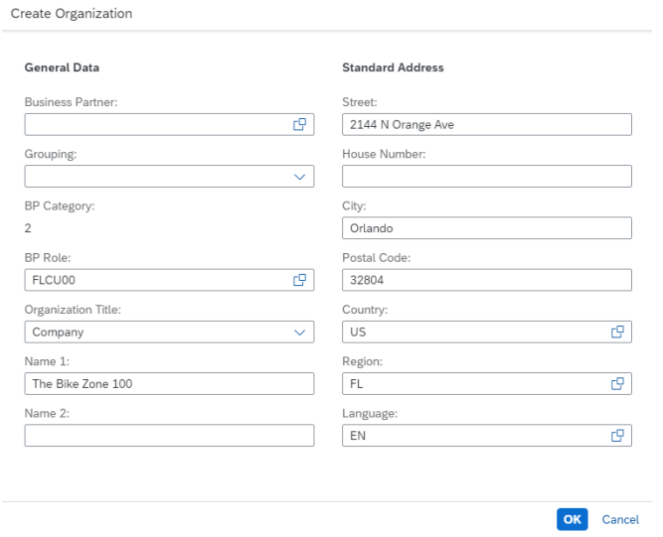

Slide 4
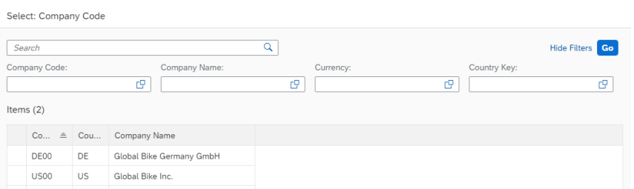
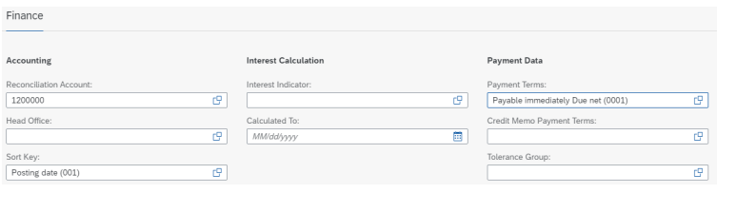
Notes:
US00
Click on US00 (Global Bike Inc.). In the Finance area, as the Reconciliation Account enter 1200000 (Trade Receivables) and as the Sort Key choose 001 (Posting Date). In the field Payment Term, please add 0001 (Payable immediately Due net).

Slide 5
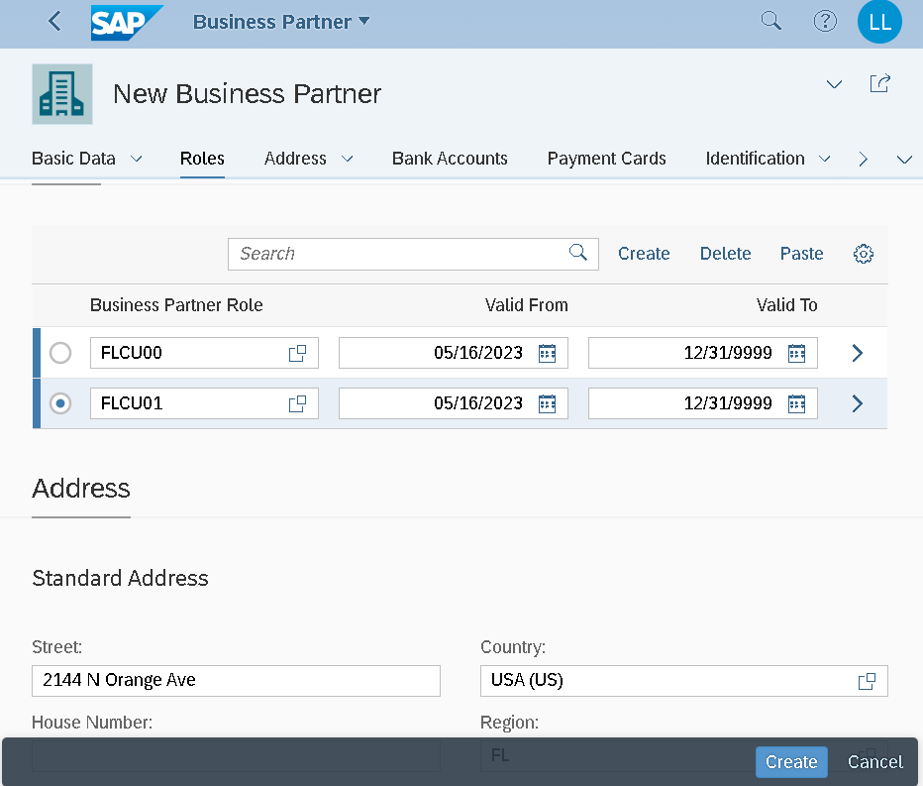
Notes:
Address → Address Details Transportation Zone Click on Region East to select it. Finally, use the button again to save your draft. At the end of the new line, you can click on to maintain more details. Switch to the tab Sales Areas to maintain the sales area data of your customer. Since no data record currently exists, select the button accordingly

Slide 6
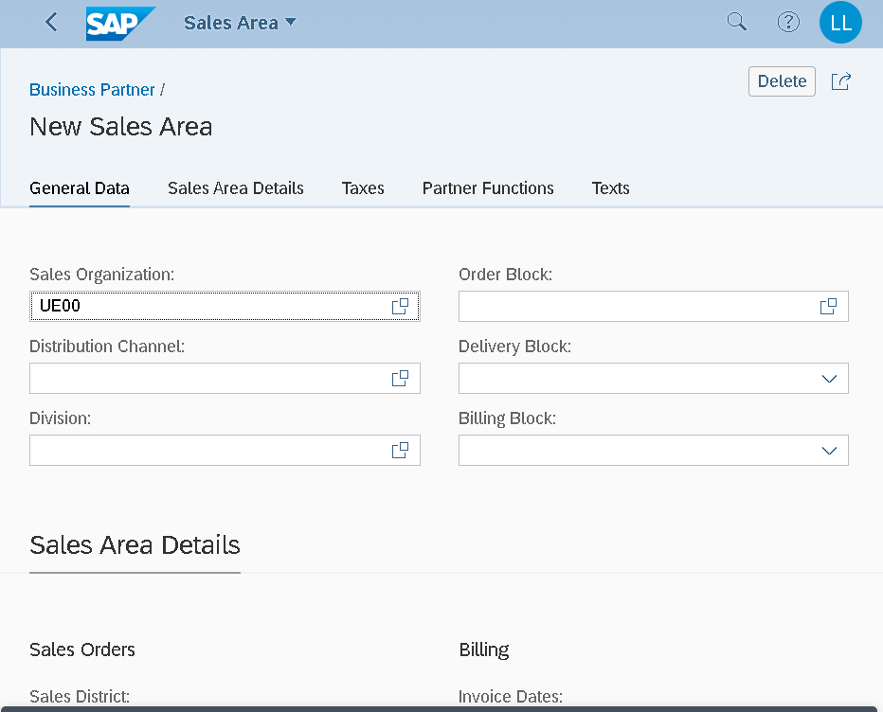
Notes:
In the field Sales organization click on the value help symbol . In the pop up window that opens, enter UE00 as the sales organization, WH (Wholesale) as the distribution channel and BI (Bicycles) as the division. Then press

Slide 7
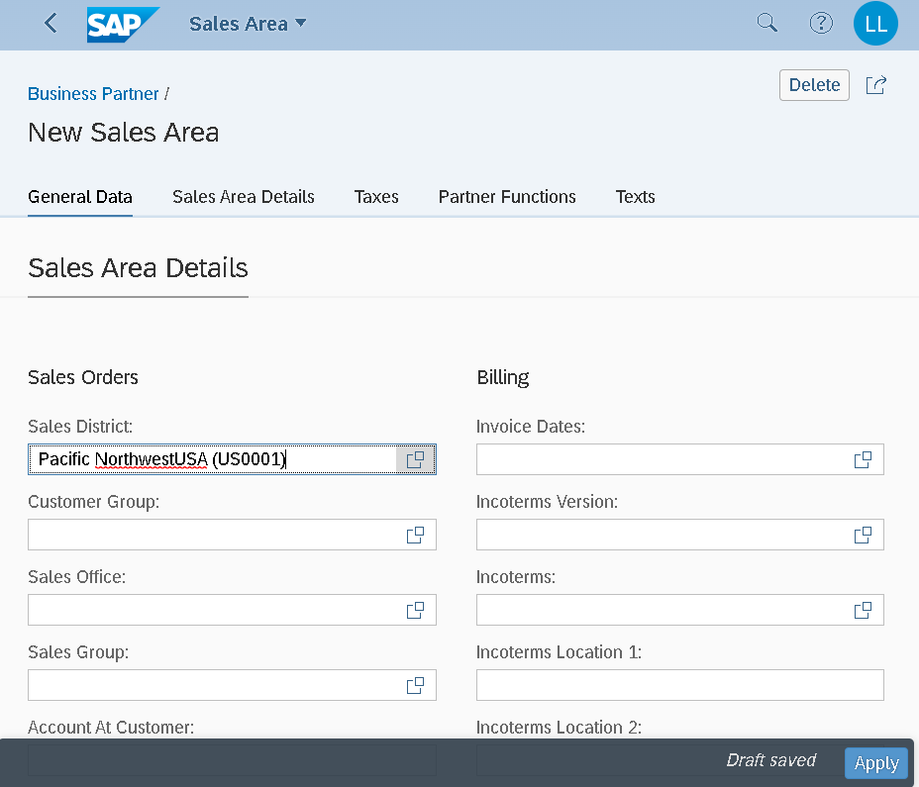
Notes:
Then select the Sales Area Details tab. In the Sales Orders section, enter US0001 as the Sales District and ensure that USD is entered as the currency In the Billing section, enter FOB (Free on Board) as the Incoterms and Miami as the Incoterms Location 1. Also add 0001 (Payable immediately Due net) as Payment Terms.

Slide 8
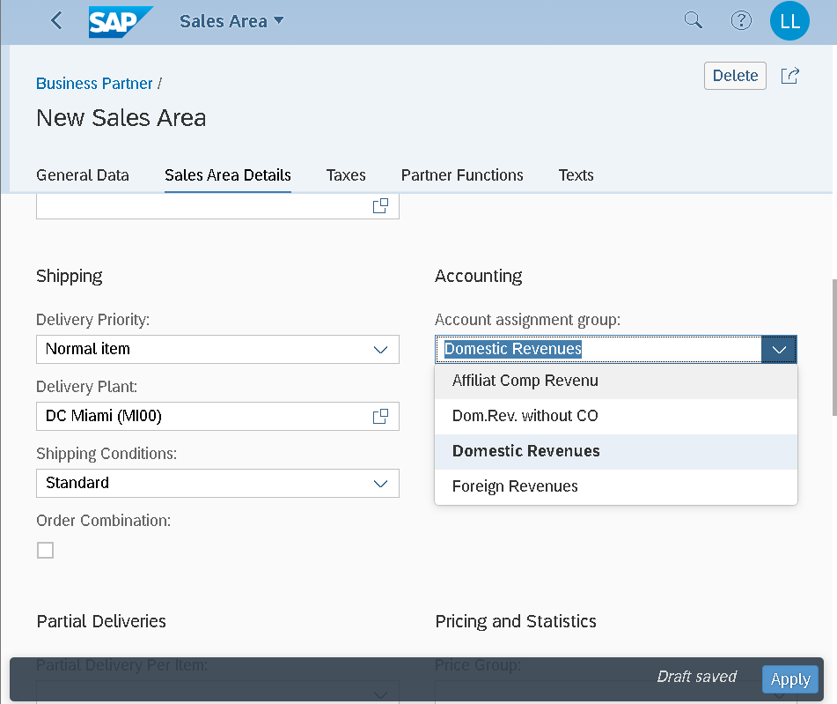
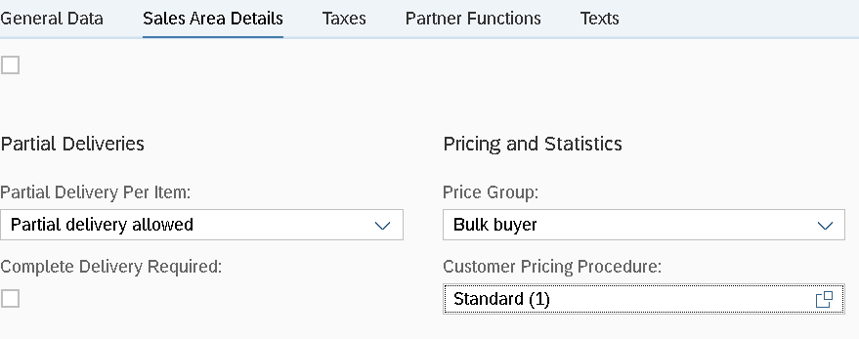
Notes:
Select the button Apply to save your adjustments as a draft. Then press to finish editing the client role. To finally save the business partner, press the buitton Create.

Slide 9
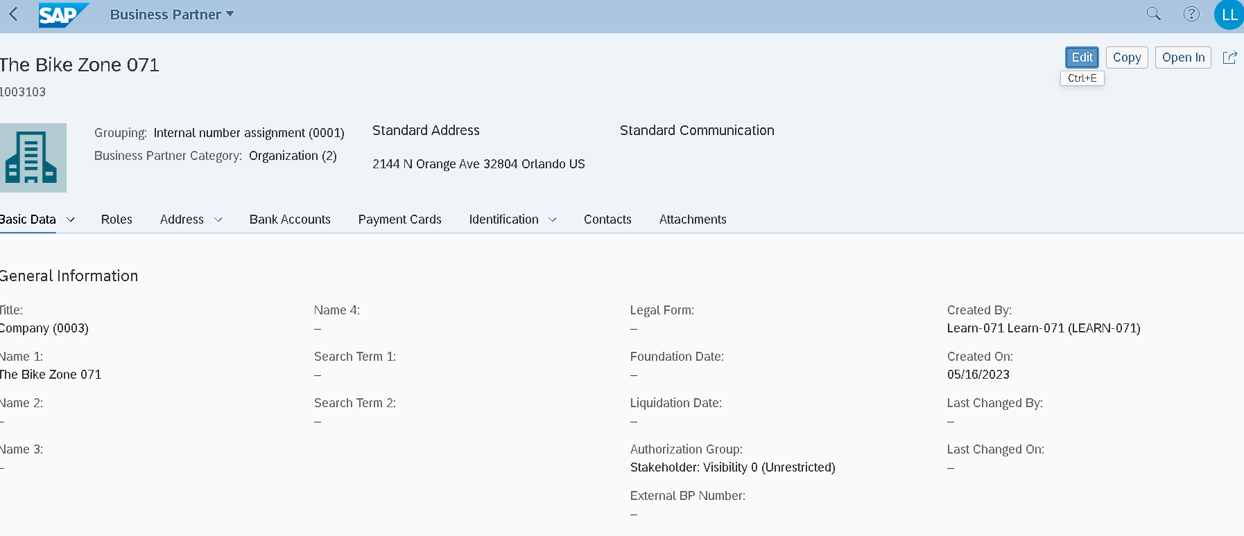
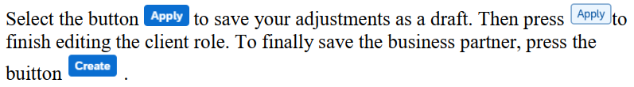
Notes:
Sau khi Apply, bấm Apply thêm lần nữa, bấm Create để kết thúc
The SAP system creates the master data record for the new BP and assigns a unique business partner number. Make a note of the BP number, which you will find in the header.

Slide 10
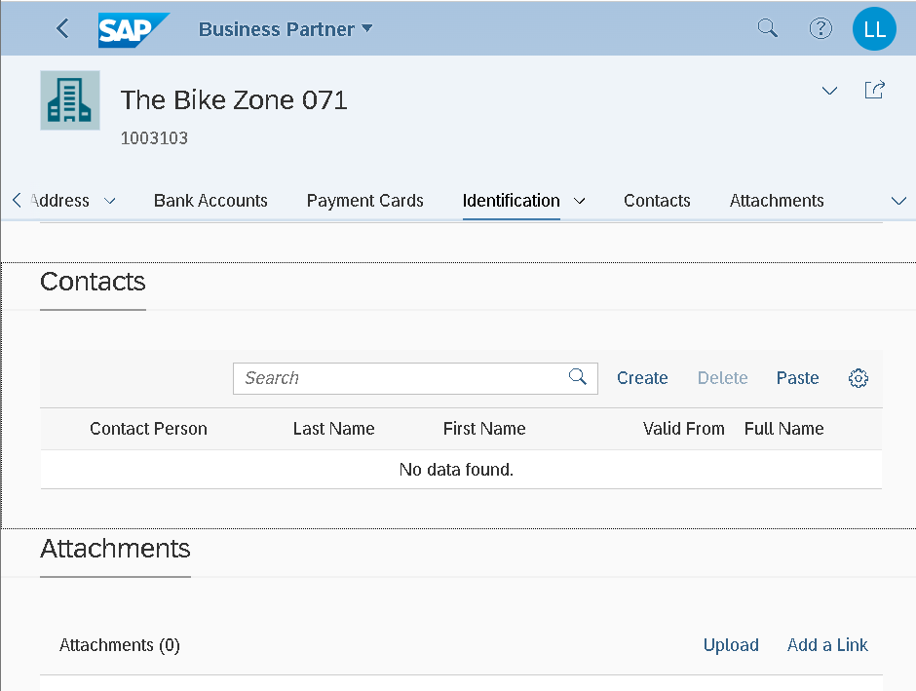
Notes:
Create Person contact

Slide 11
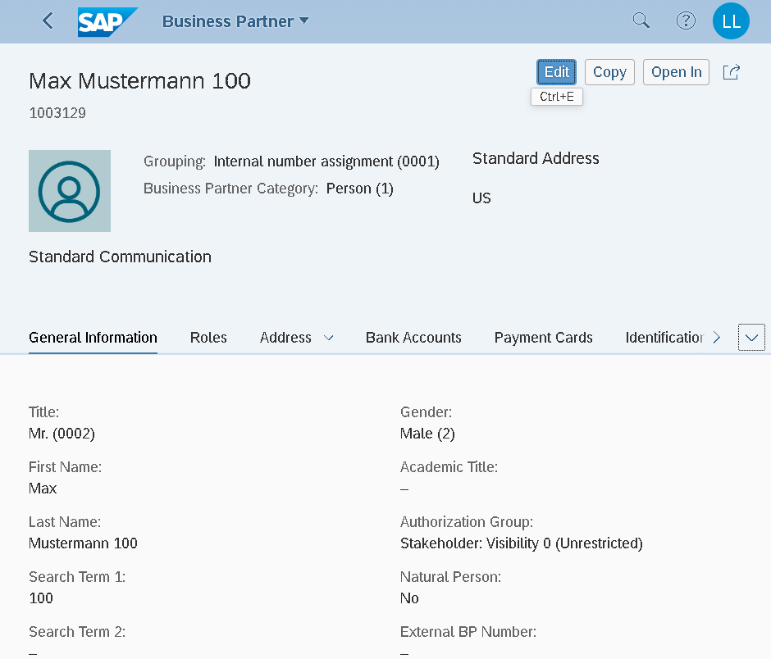

Slide 12
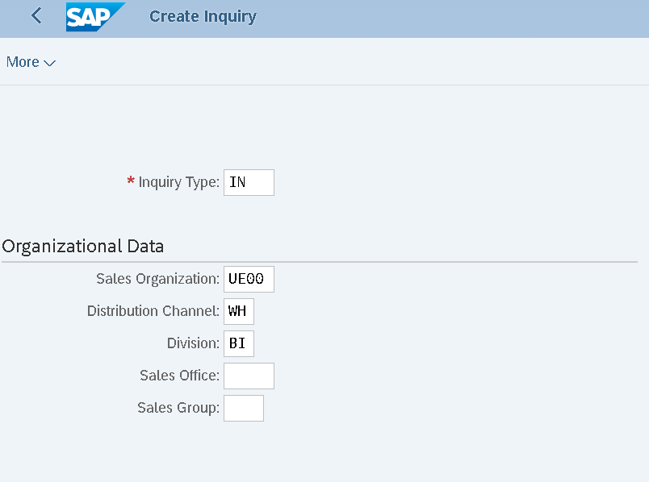
Notes:
Create Inquiry

Slide 13
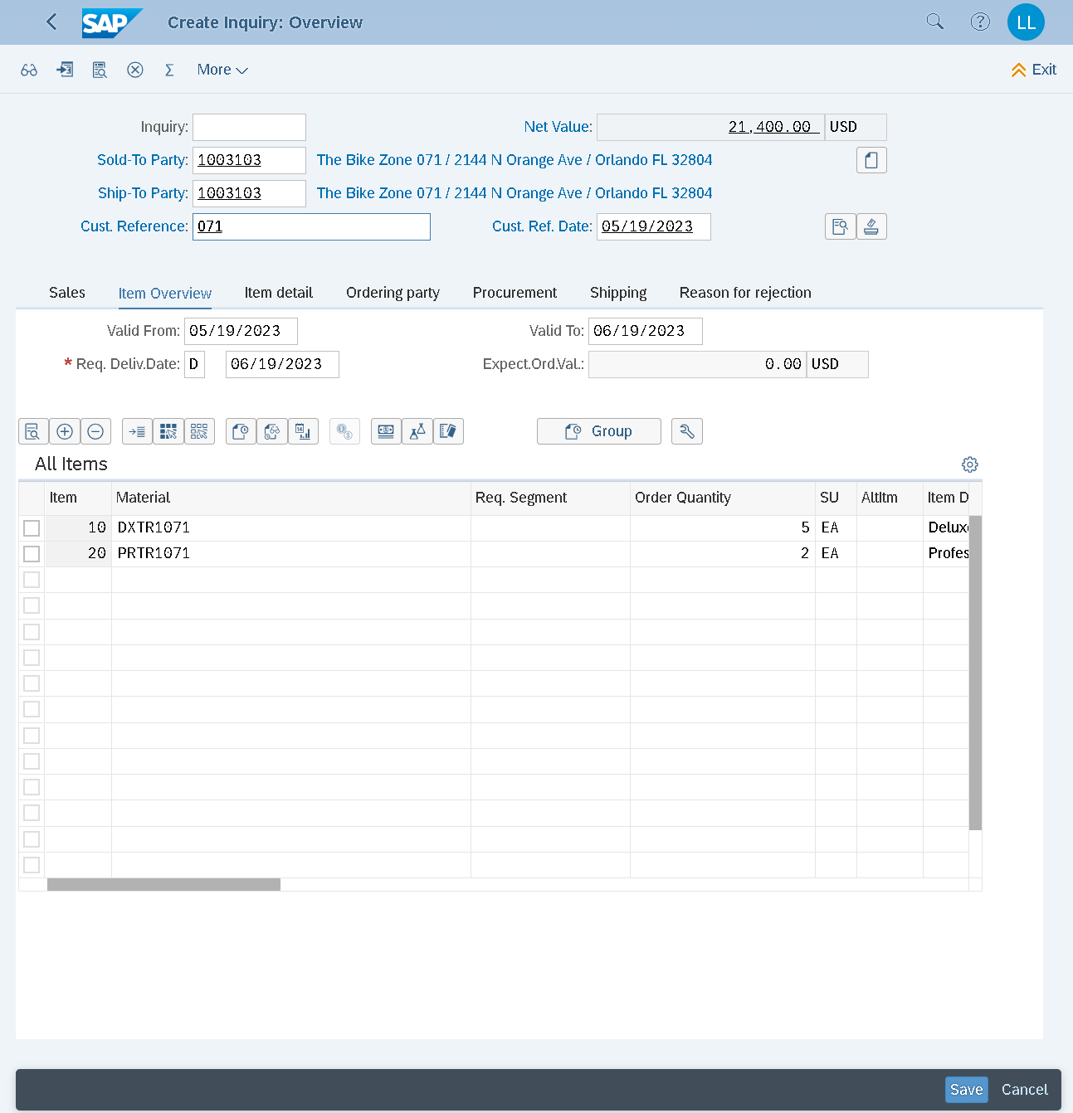

Slide 14
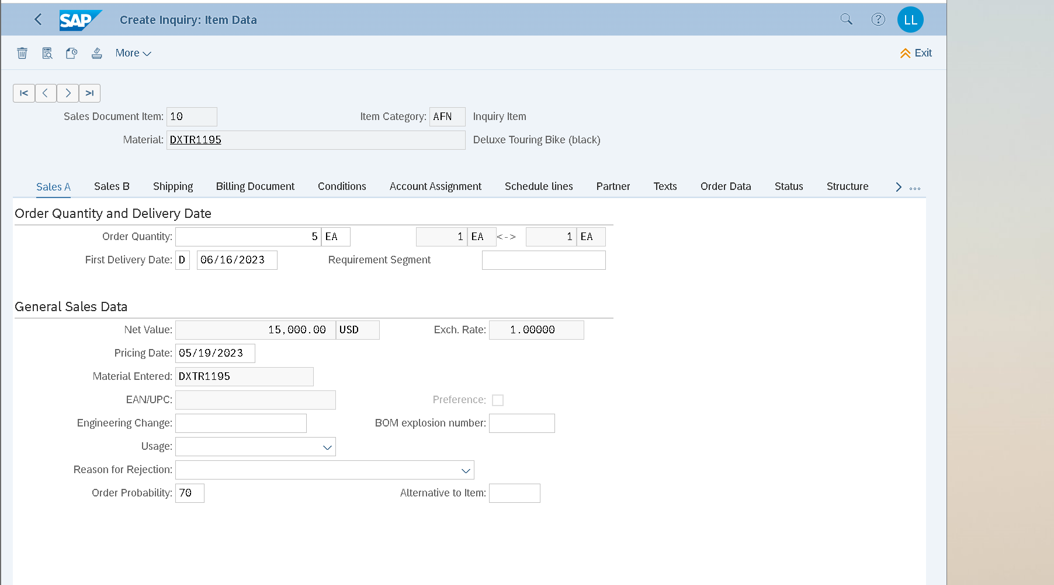
Notes:
Next item mũi tên góc trên
Set probability 70% cho 2 mã sp

Slide 15
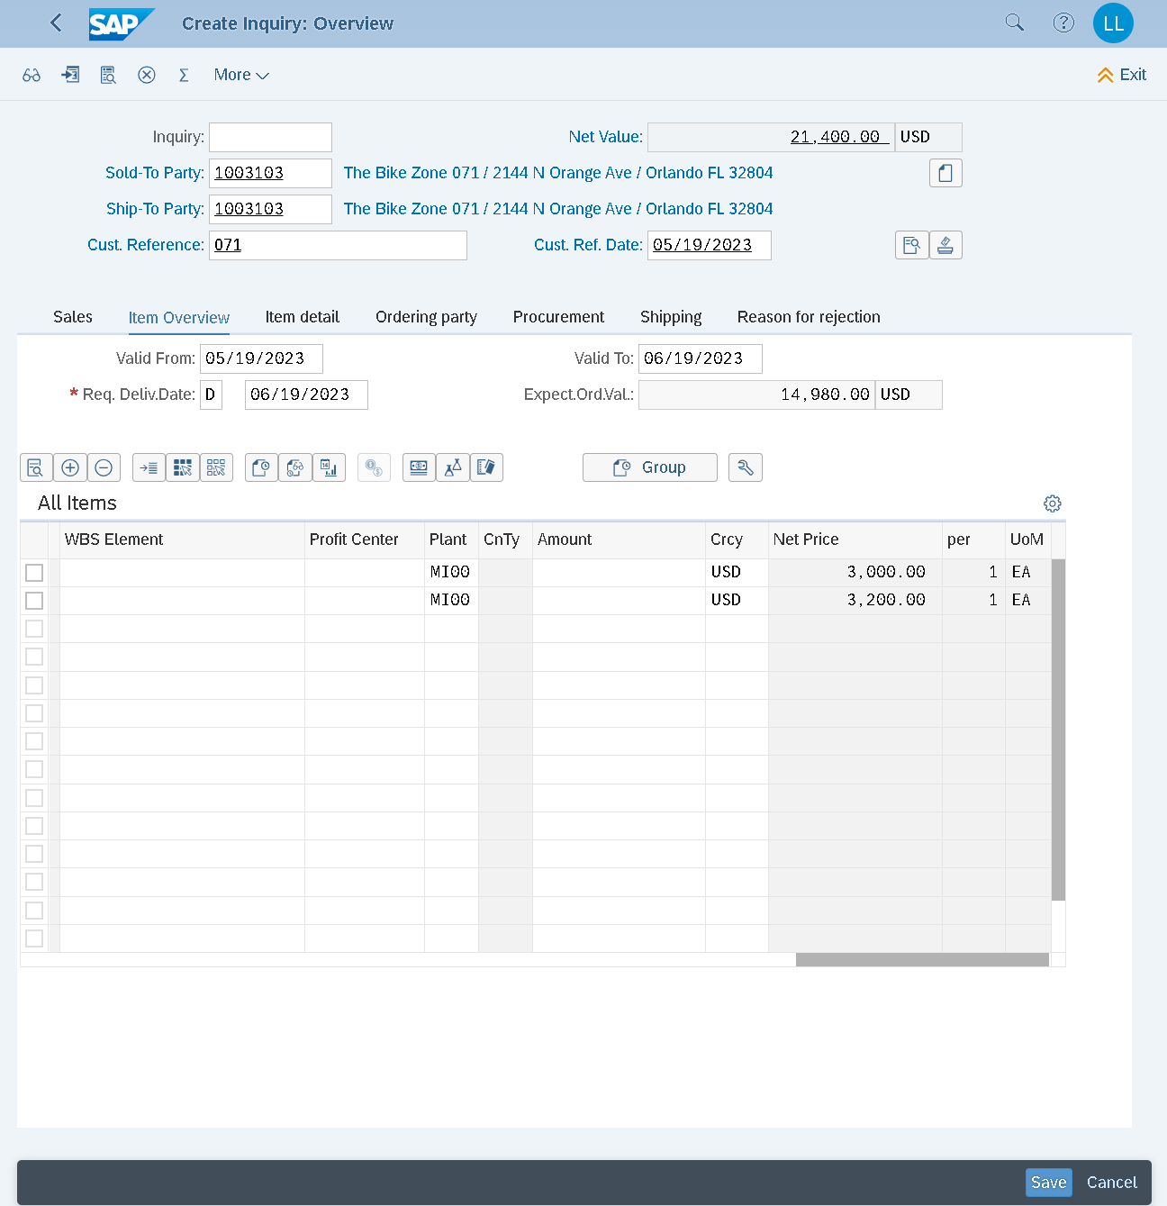
Notes:
Complete Sales inquiry => Save => Inquiry doc. number

Slide 16
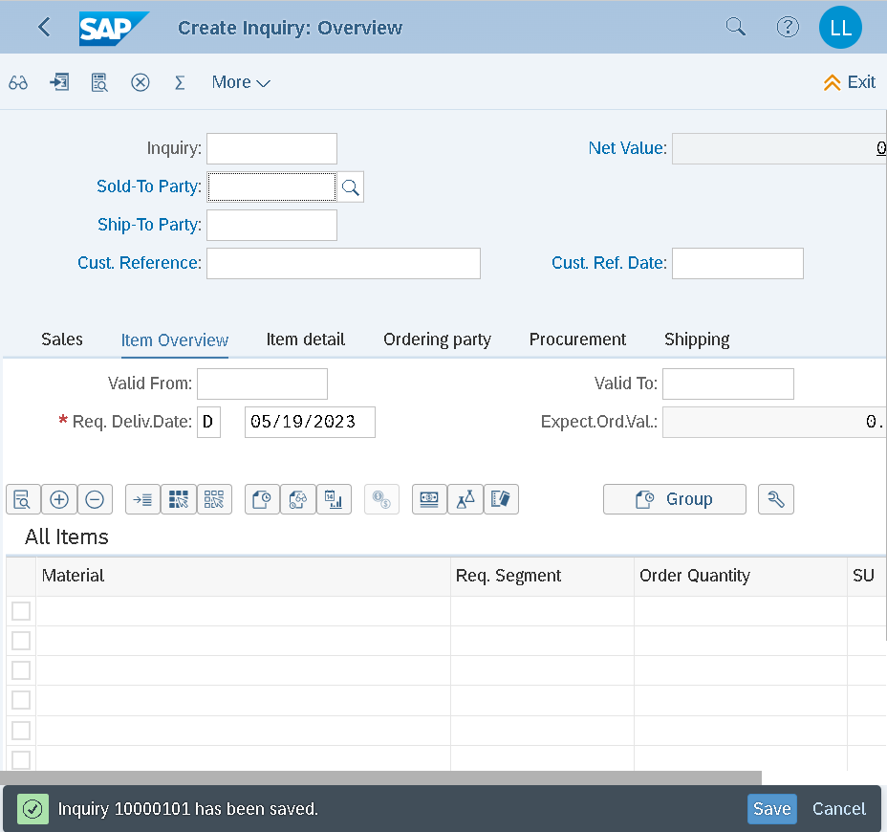
Notes:
10000101
Inquiry number

Slide 17
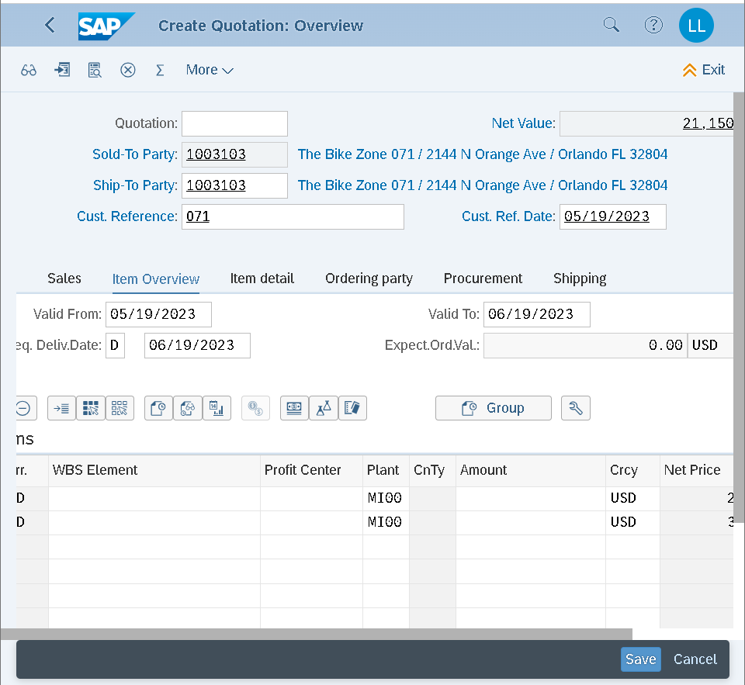
Notes:
Tạo quotation (đơn báo giá) có option “Create with reference” chuyển dữ liệu từ Inquiry number để gắn với Yêu cầu báo giá của kh
21400: 5 xe DXTR = 15k; 2 xe PRTR = 6400 (3200*2) => thao tac chiết khấu từng sp hoặc tổng đơn hàng
Apply discount 5% cho DXTR (giảm $250 5 xe/$50 mỗi xe) => new total price =21150
PR00 price (retail/gross price)
K004 trade discount
SKT0 (cash discount)
Surcharge after discount
Tax
Net value (net price)
Lỗi tạo/save quotation ko tạo dc quotation mới: do inquiry trước đó đã được ref hết stock

Slide 18
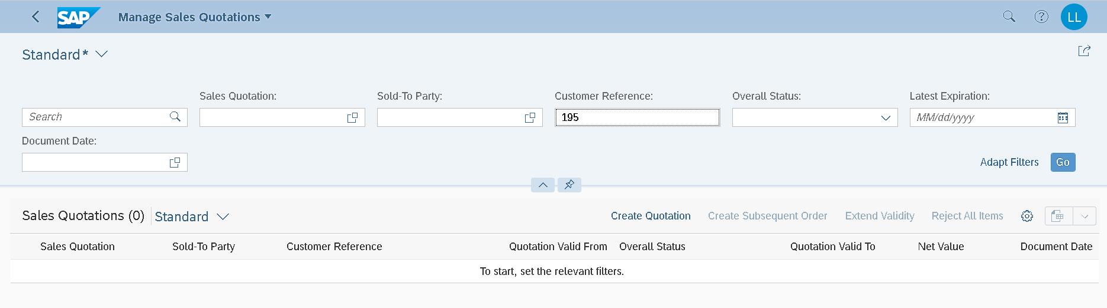
Notes:
Search quotation theo Customer ref.
Bấm chọn vùng trống line quotation để Edit

Slide 19
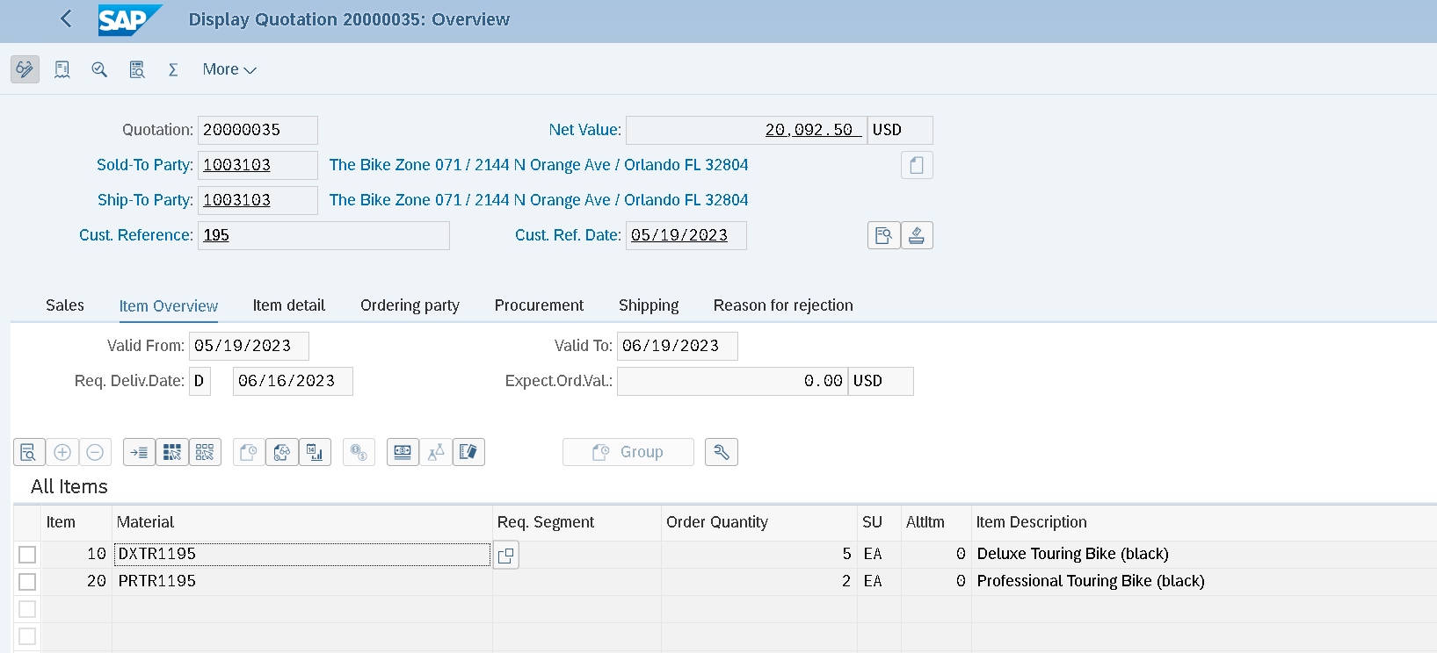
Notes:
Edit quotation

Slide 20
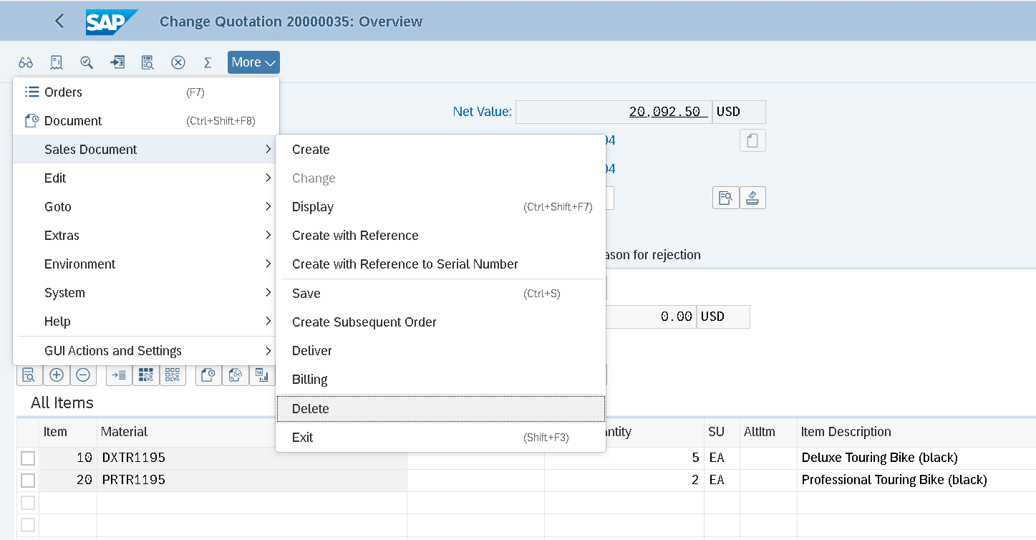
Notes:
Delete quotation (xóa hẳn khỏi hệ thống)
Hoặc Reject quotation: status chuyển trạn thái complete để vẫn lưu thông tin quotation nhưng ko process nữa

Slide 21
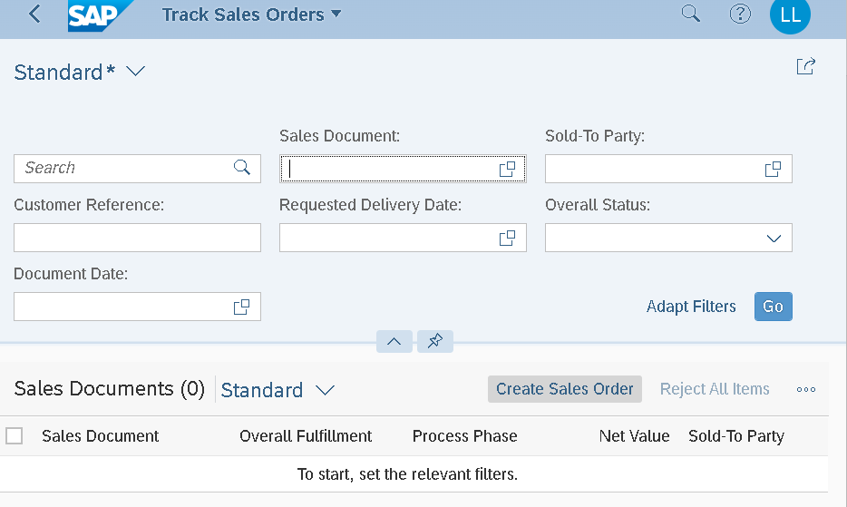
Notes:
App Manage Sales orders bị lỗi, dùng thay thế Track sales orders

Slide 22
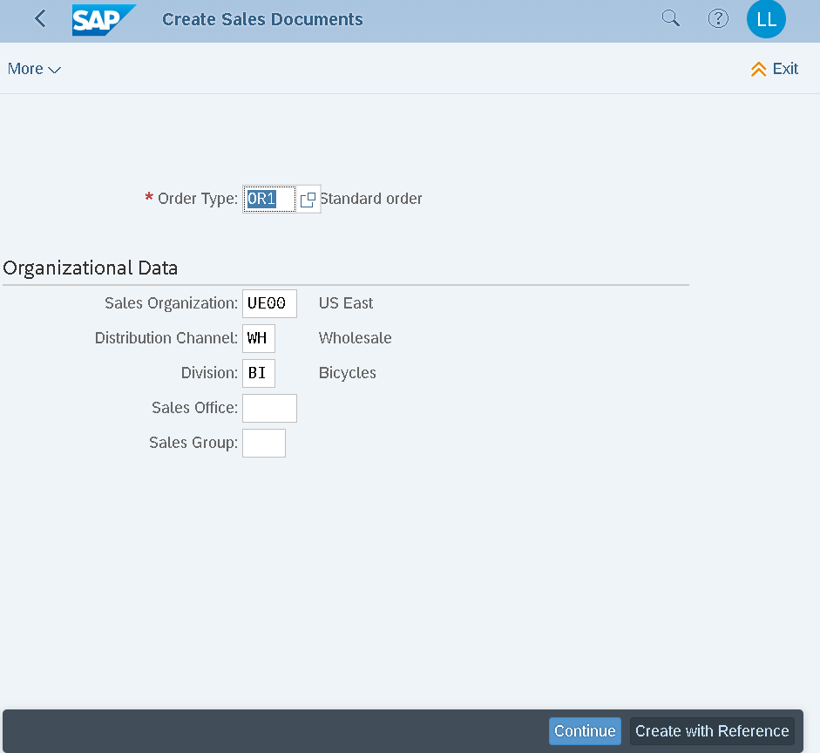
Notes:
Create with ref: search theo Customer ref hoặc Quotation number

Slide 23
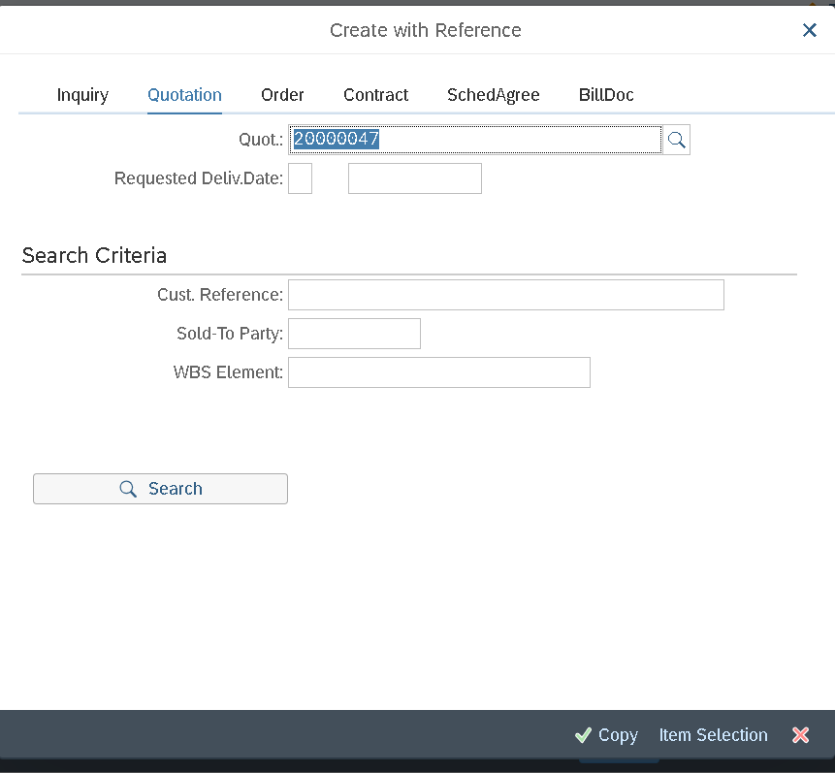

Slide 24
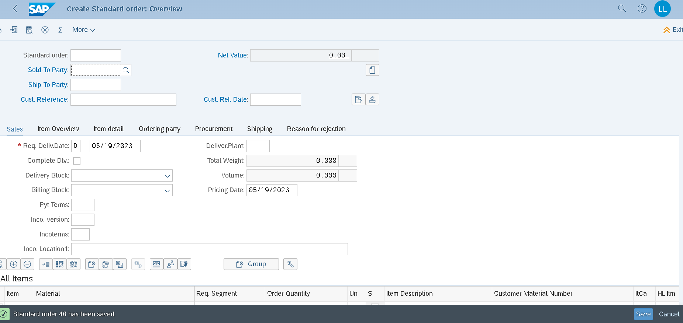
Notes:
Sales order doc 46
EXIT trên góc màn hình

Slide 25
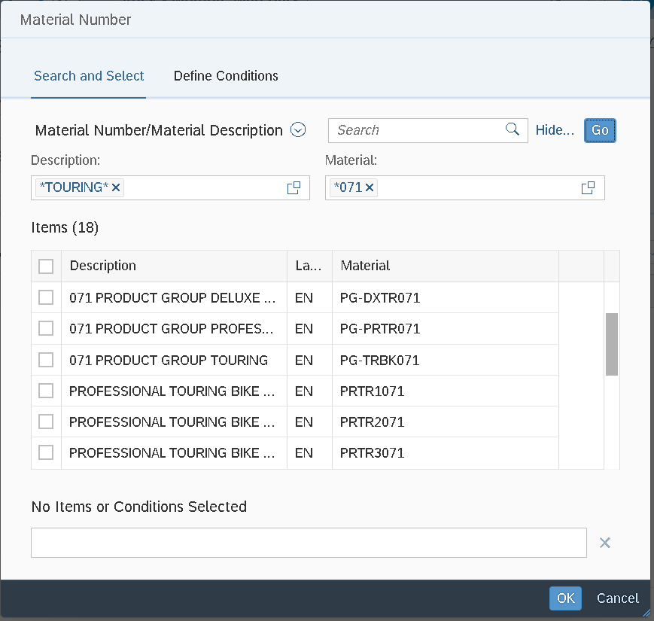
Notes:
Check stock status: search => bấm Go để tìm, Enter ko lưu
Tick chọn 2 mã sp (BLACK)

Slide 26
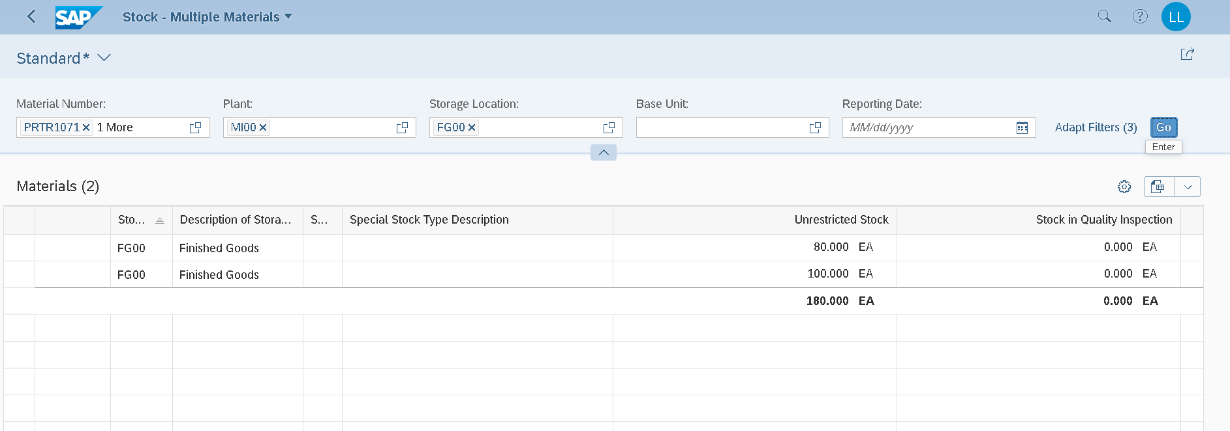
Notes:
Điền Plant, Storage loc
Check sl stock 80/100

Slide 27
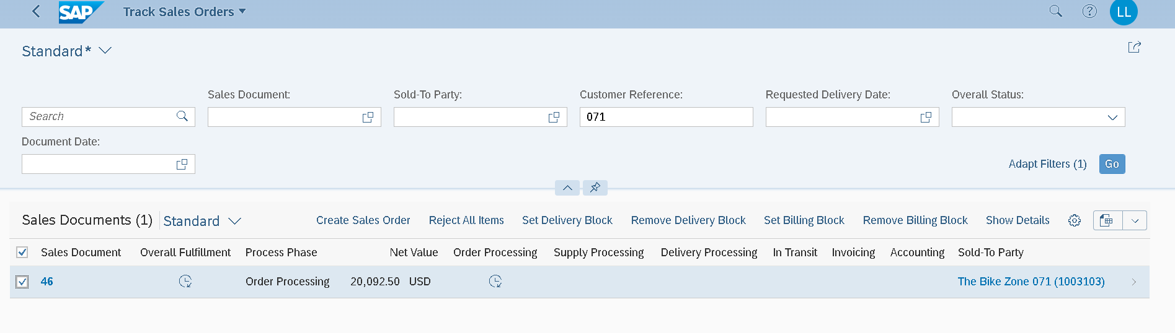
Notes:
TRACK SALES ORDER
Overall Fulfillment status or the Net Value. BẤM CHỌN vùng trống trong line Sales order

Slide 28
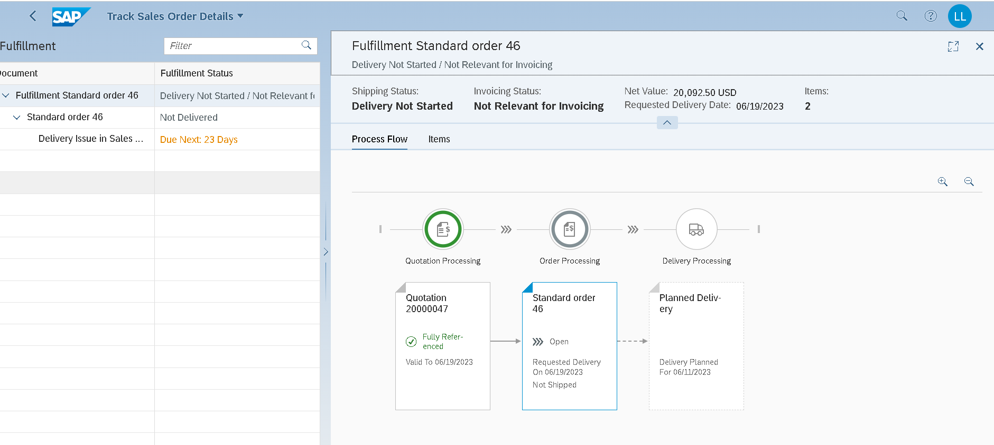
Notes:
the quotation processing has been fully processed (“fully referenced”), but that the processing of the standard order is currently still “open”. You can also see the requested delivery date of the order and the planned delivery in the overview

Slide 29
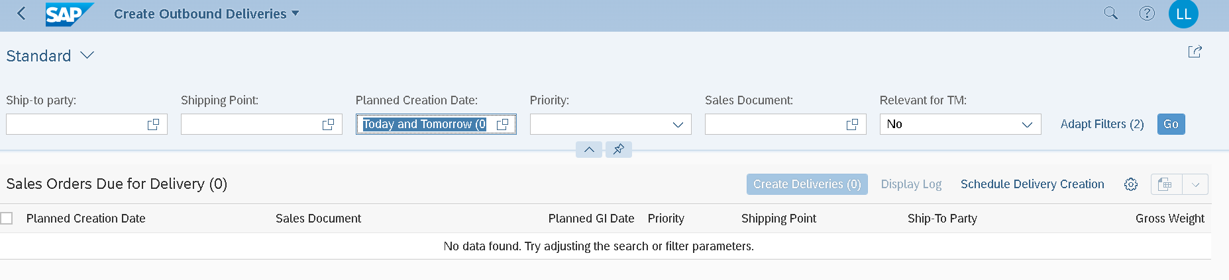
Notes:
Xóa trường search có sẵn “Today and Tmr” thay sales doc 46
Hiện dòng Sales order 46, tick chọn line, Create deliveries => lỗi Log

Slide 30
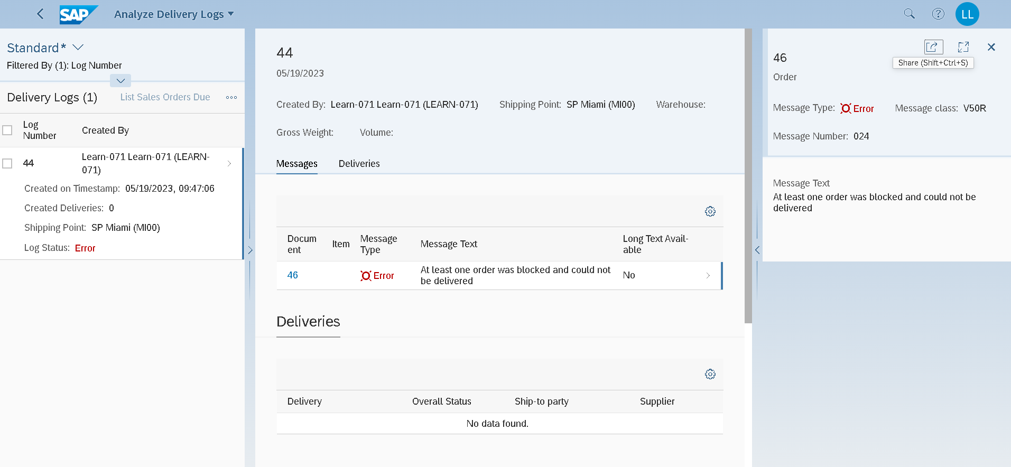
Notes:
Màn hình lỗi Outbound deliveries
Lỗi này thường do trong lúc thao tác các bước, SAP lưu cookies nên xem bước đó chưa dc Save => Logout User => ko login lại dc thì thoát Browser

Slide 31
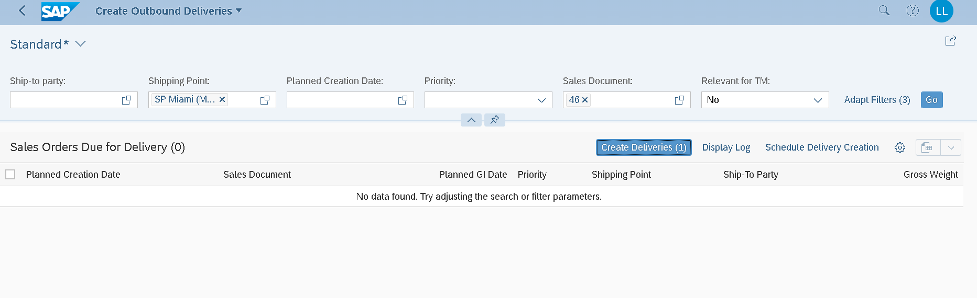
Notes:
Nếu tạo Sales deliveries thành công, dòng Sales order biến mất
Select the sales document and choose the button Create deliveries . You will see that the sales document is no longer available. Additionally, you will receive a confirmation that your outbound delivery has been created.

Slide 32
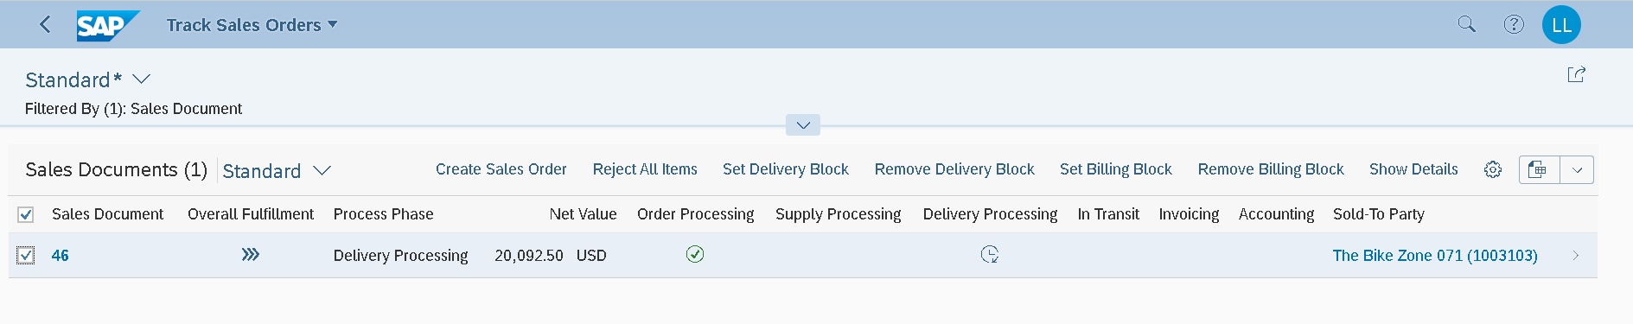
Notes:
Track Order status
The Overall Fulfillment is now set to Partially processed and the Order Processing is completely processed.
Bấm chọn dòng Sales order

Slide 33
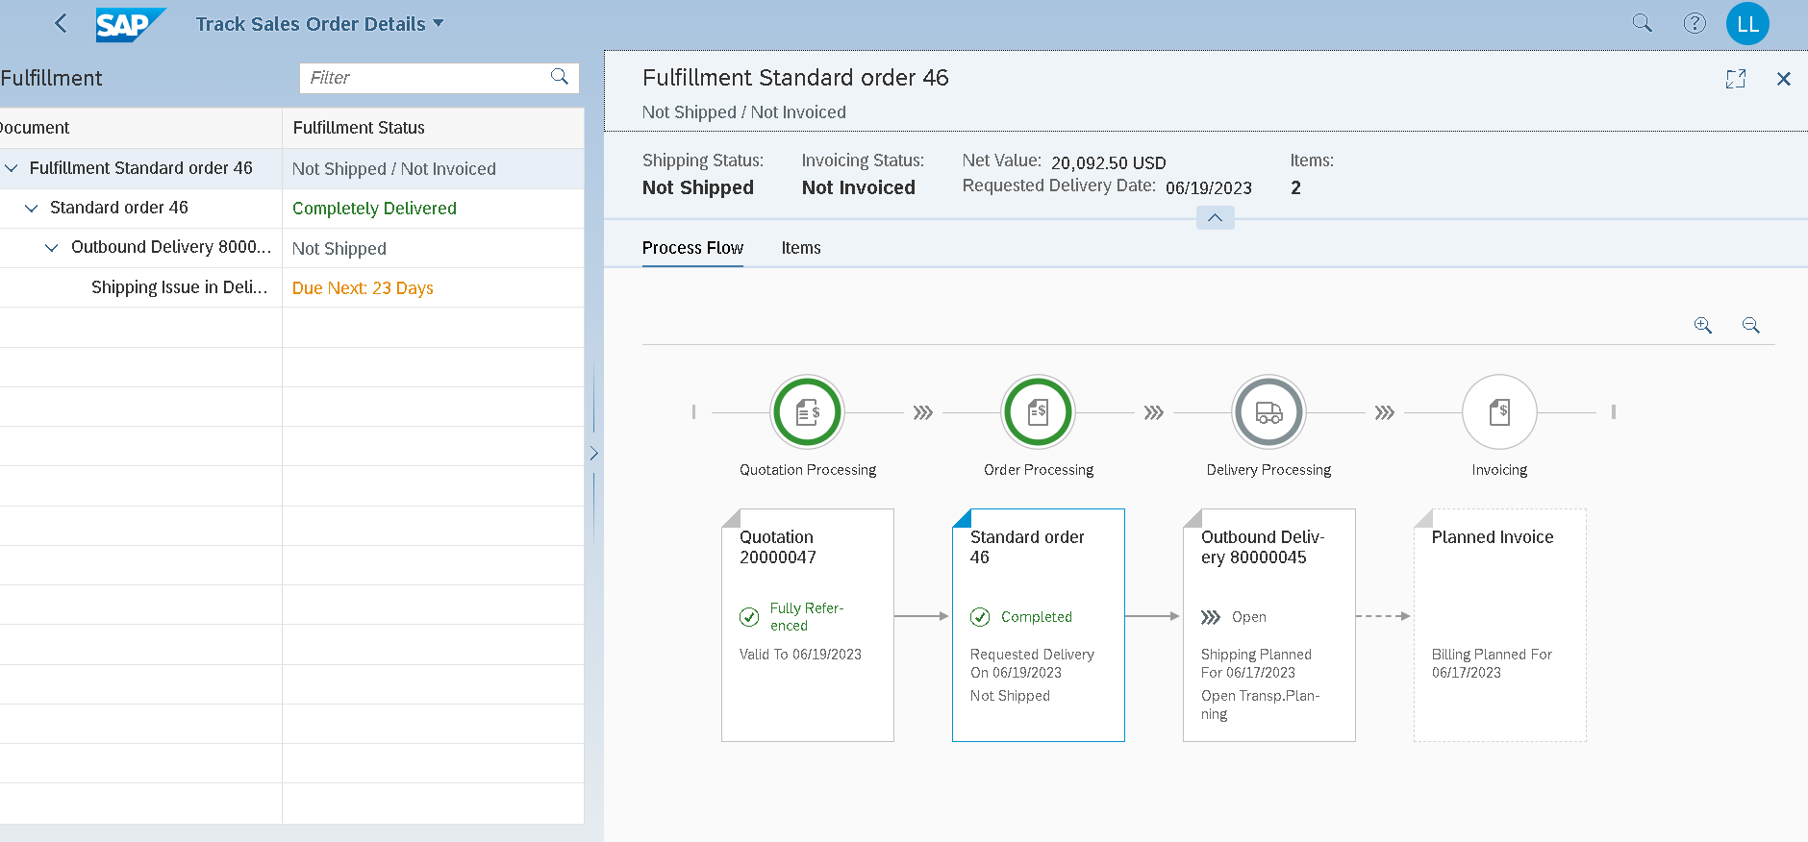
Notes:
In the overview that opens, you can see the completed standard order and the delivery that is still “open”. In addition, billing has already been planned automatically by the system. In the header area, the shipping status (Not shipped; previously: Delivery Not Started) and the billing status (Not invoiced, previously: Not Relevant for Invoicing) have also changed
Lưu ý note số Outbound delivery: 80000045

Slide 34
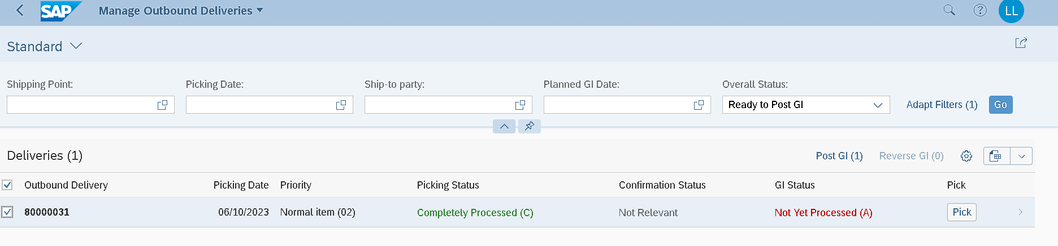
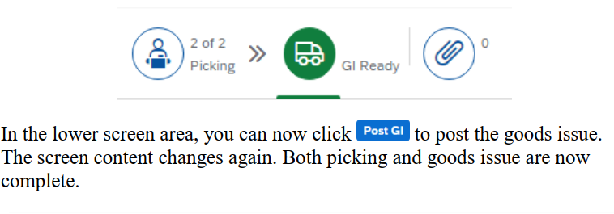
Notes:
Search theo số Deliveries => bấm Chọn Pick

Slide 35
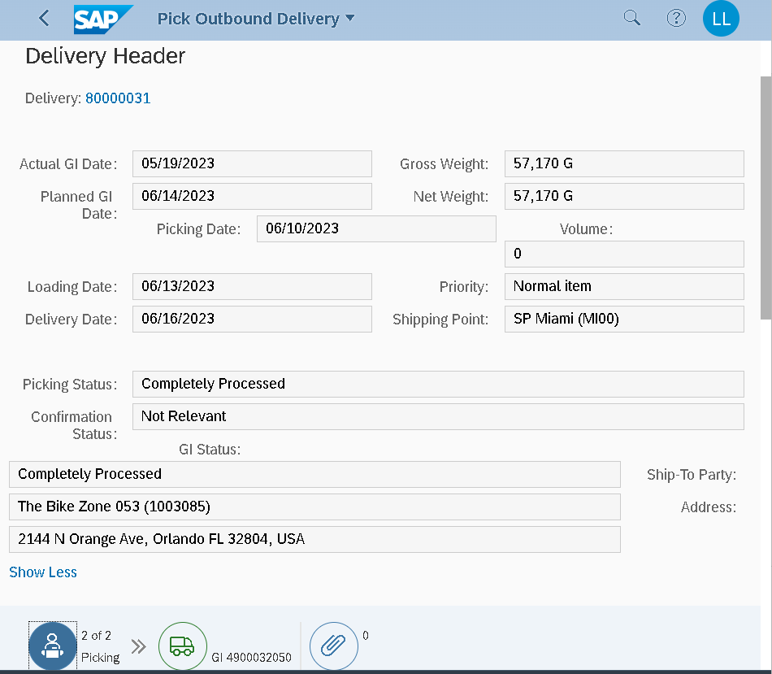
Notes:
Xe tải chưa xanh GL ready, PGI not processed

Slide 36
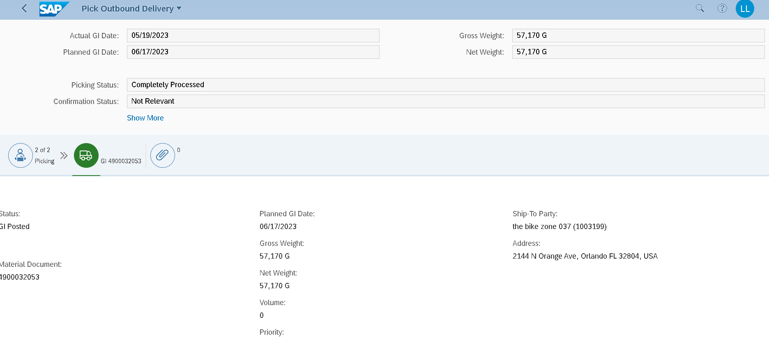
Notes:
Xe tải xanh GL processed (có hiện doc. Number)
4900032053

Slide 37
Notes:
Trong Track Sales orders vẫn chưa báo GL processed, or tick xanh Shipped => chọn trên màn hình này để dẫn tới Edit Outbound deliveries

Slide 38
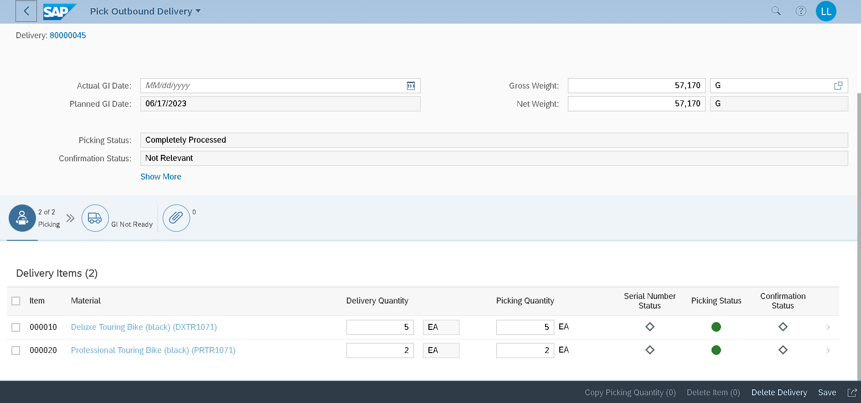

Slide 39
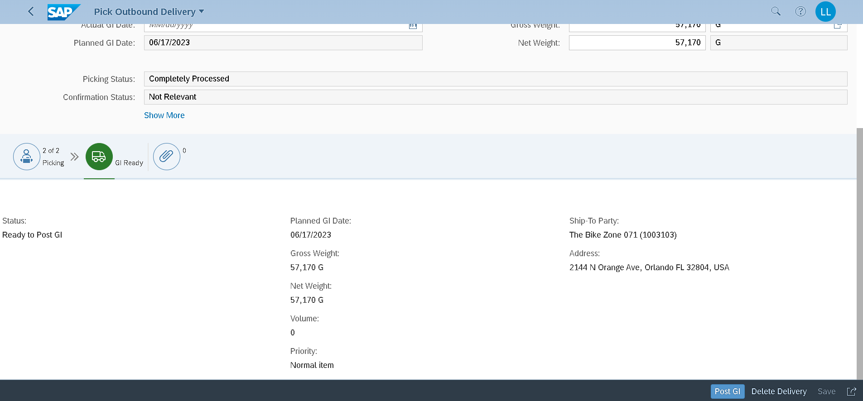
Notes:
4900032058
GI number (post goods issued)

Slide 40
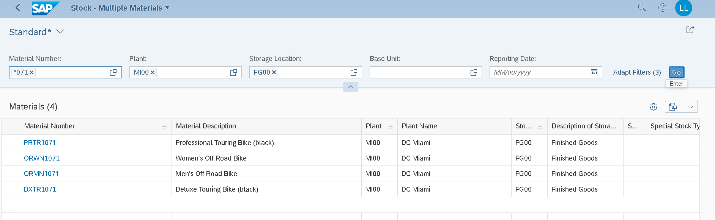
Notes:
Check stock status after delivered

Slide 41
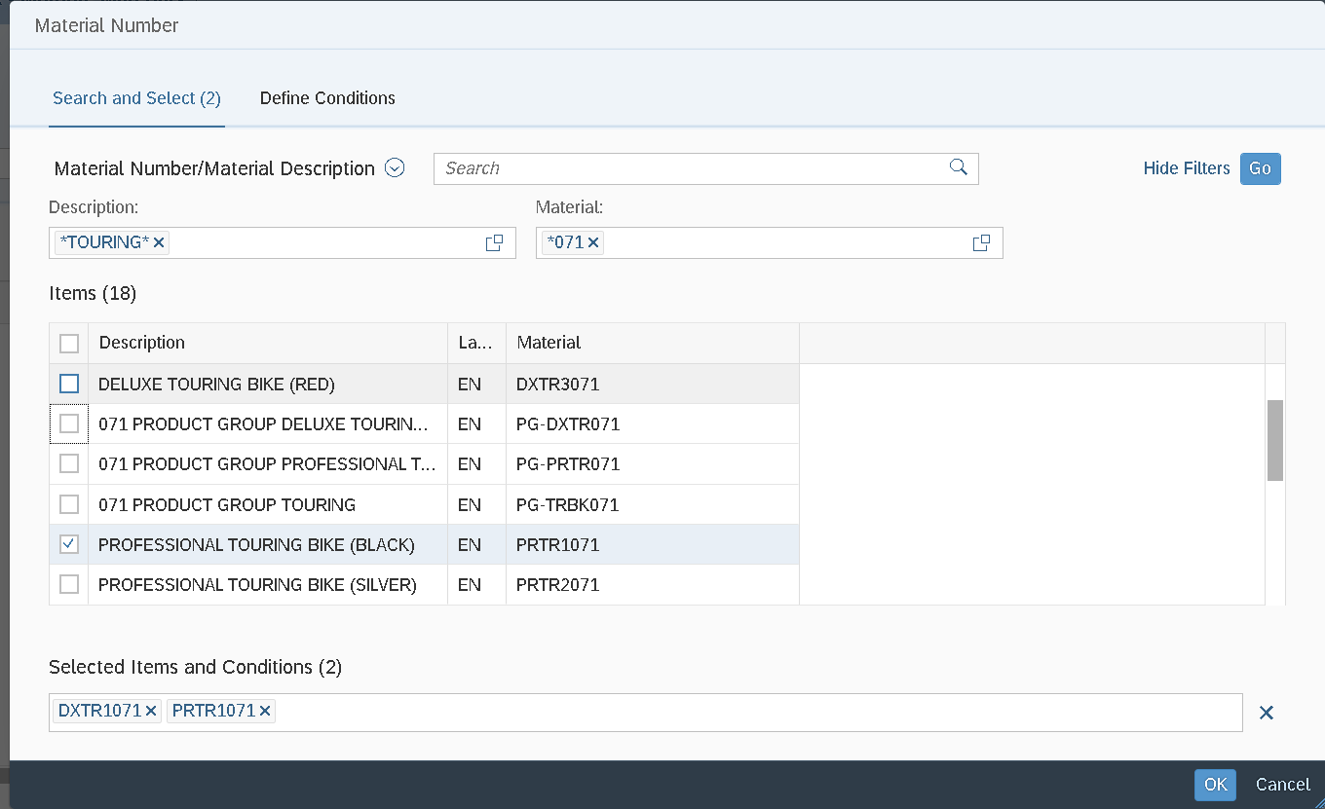
Notes:
Step 12 check stock status after post GL

Slide 42
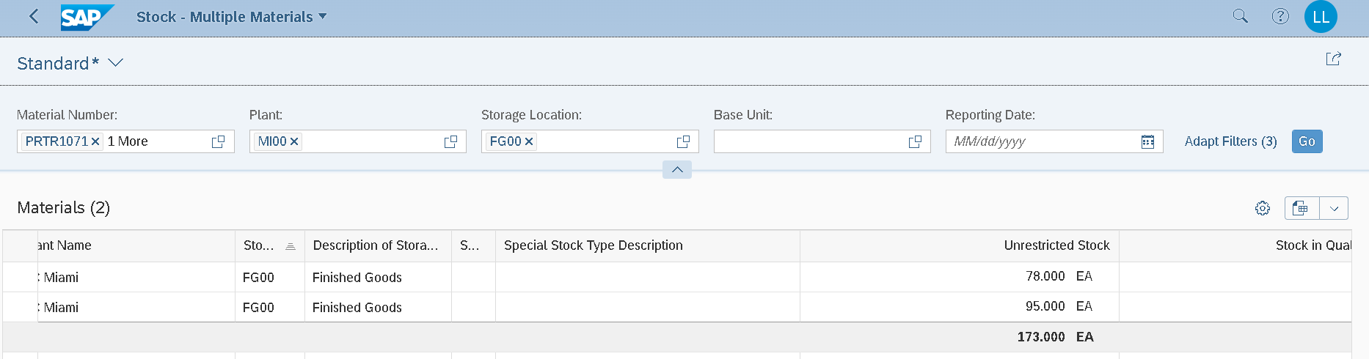

Slide 43
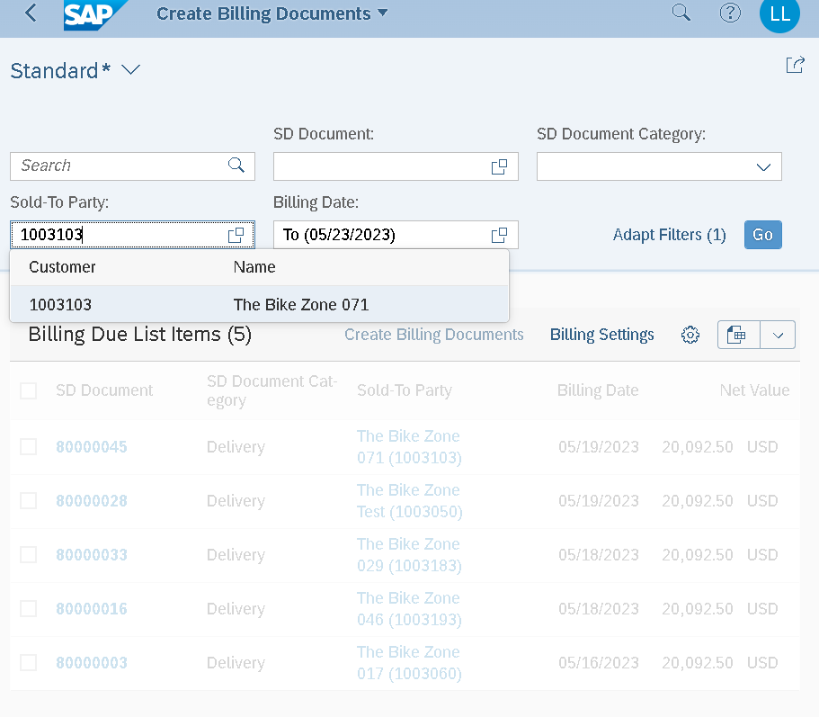
Notes:
BP number

Slide 44
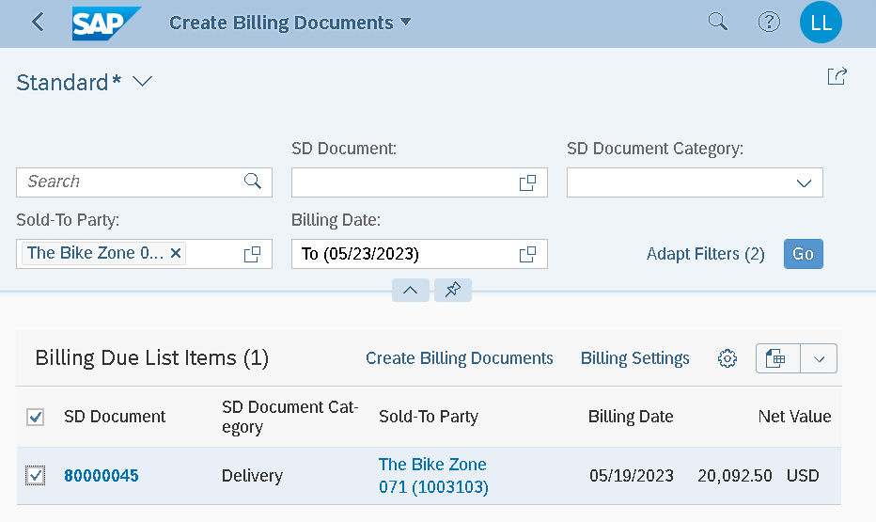
Notes:
Tick chon BP => Create Bill

Slide 45
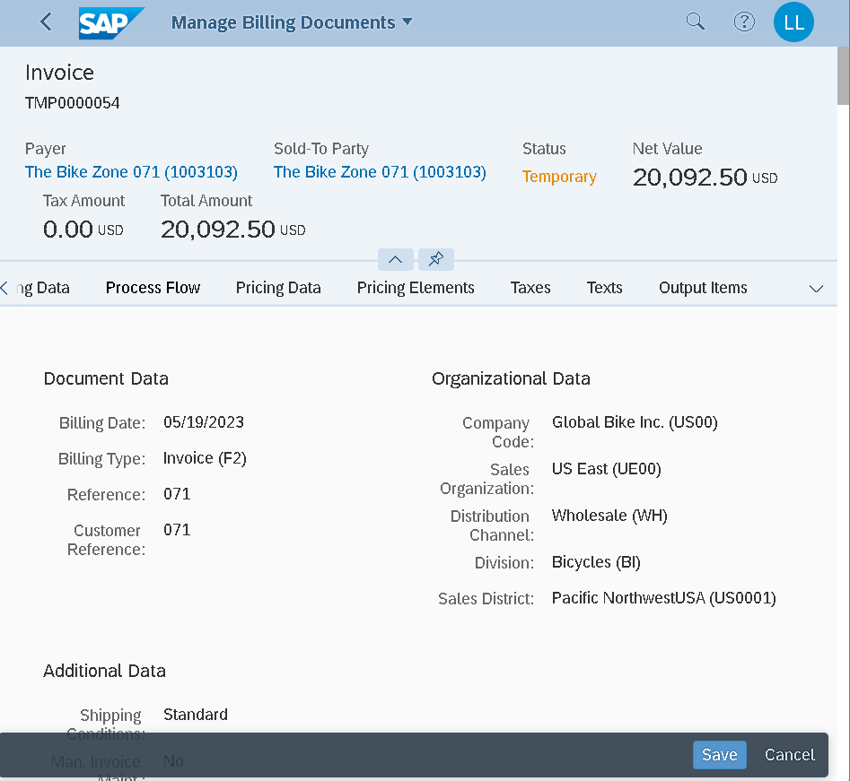

Slide 46
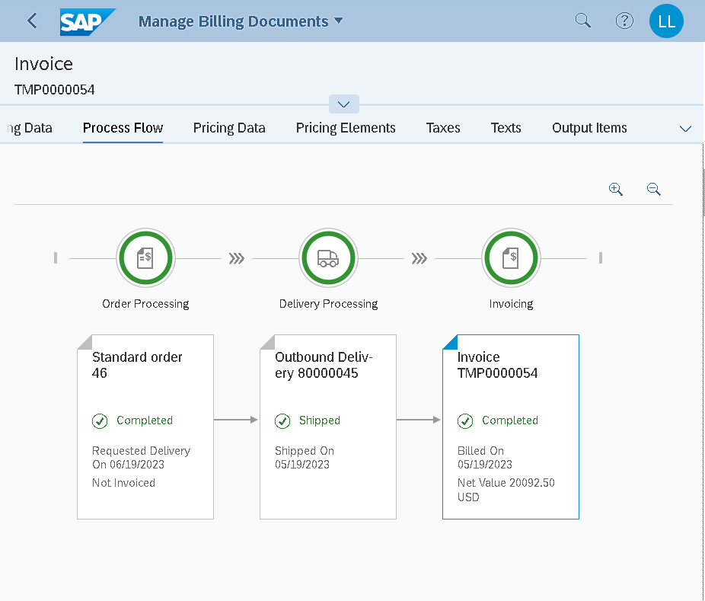

Slide 47

Notes:
Save => Invoice number 90000055

Slide 48

Notes:
Step 14: post Invoice (to GL)

